Slide 1


Team 30: Smart Pest Repeller
Bi-Weekly Update 5 Andrew Albritton
Michael McNeil
Melquisedec Ordonez Sponsor: Peng Hao Huang TA: Eric Robles
Notes:
Michelle

Slide 2
Project Summary
According to the ASPCA, of the 230,000 animals helped by their poison control center in 2019, about 10-15% suffered from issues related to pesticide exposure. Even with these downsides, pesticides are still the most used form of pest control because alternative methods such as ultrasonic(US) sound have shown to be much less effective.
The drawback to US is due to most devices on the market having a single programmed frequency output for sound. Since different pests will be deterred by different frequency responses, while one type of pest may be deterred by the US device, other types of pest will remain.
Our solution to the problem with the efficacy of US devices is to design a US emitter system that uses a machine learning detection program to detect what type of pest is present, and then emit the frequency response that is effective for that pest type. This solution will be a much safer alternative to pesticides while also being much more effective than other US pest control devices on the market.
Notes:
Kyle

Slide 3
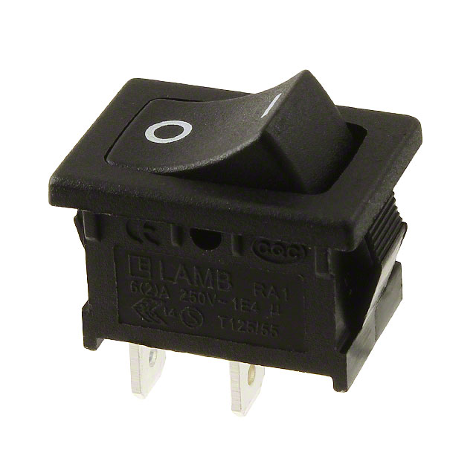
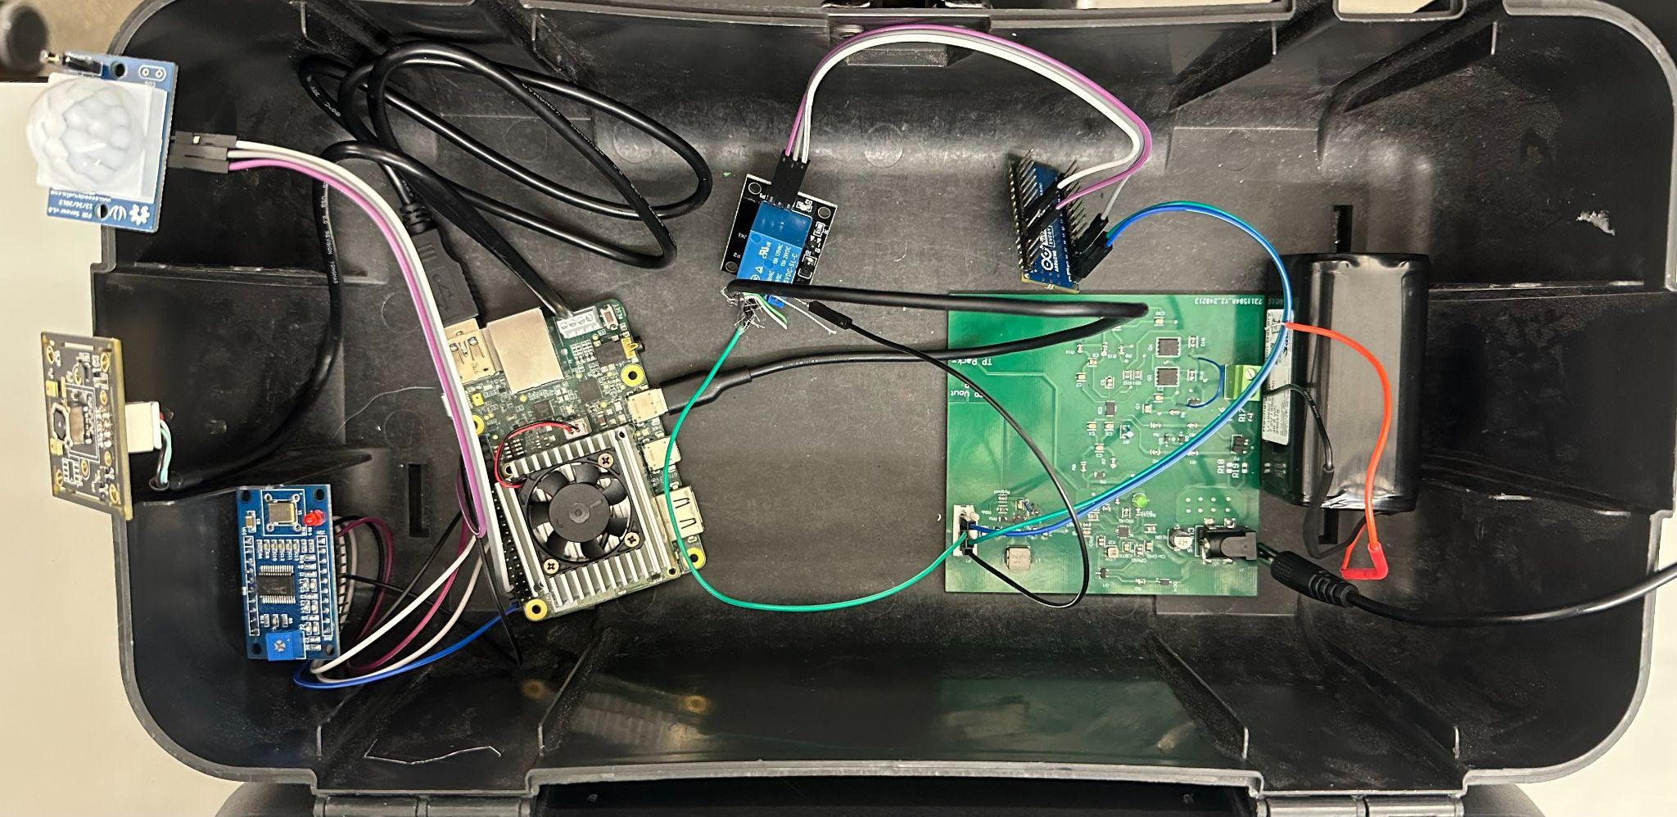
On/Off Switch
Battery Power Relay Relay MCU Signal Camera Motion
Supply Control Generation Sensor
(on/off switch for users)
The user will only be able to access the on/off switch. When the system is powered it will immediately begin sensing for motion and running detection. When the user turns the system off, the microcontroller will receive a signal from the arduino to begin shutdown. After 10 seconds, the relay will be switched off, cutting power to the MCU. Camera is connected via USB, signal generation connected via, SPI, and motion sensor/Arduino are connected via GPIO.

Slide 4
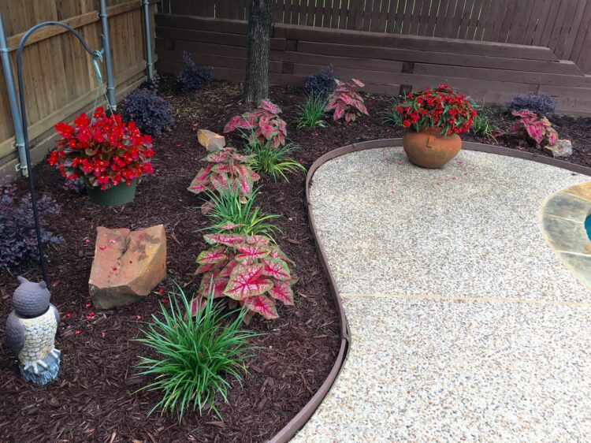
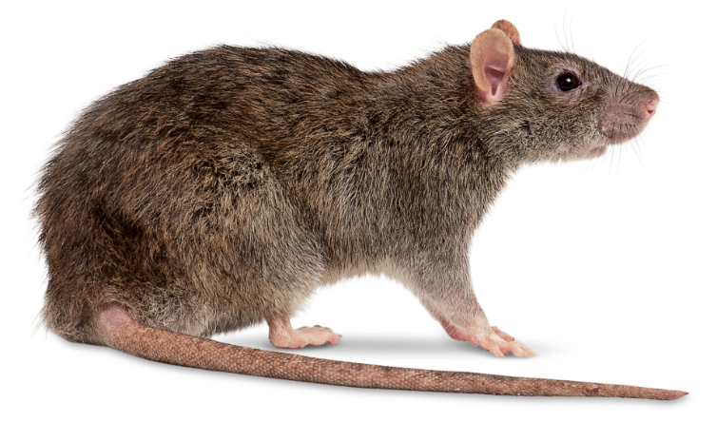
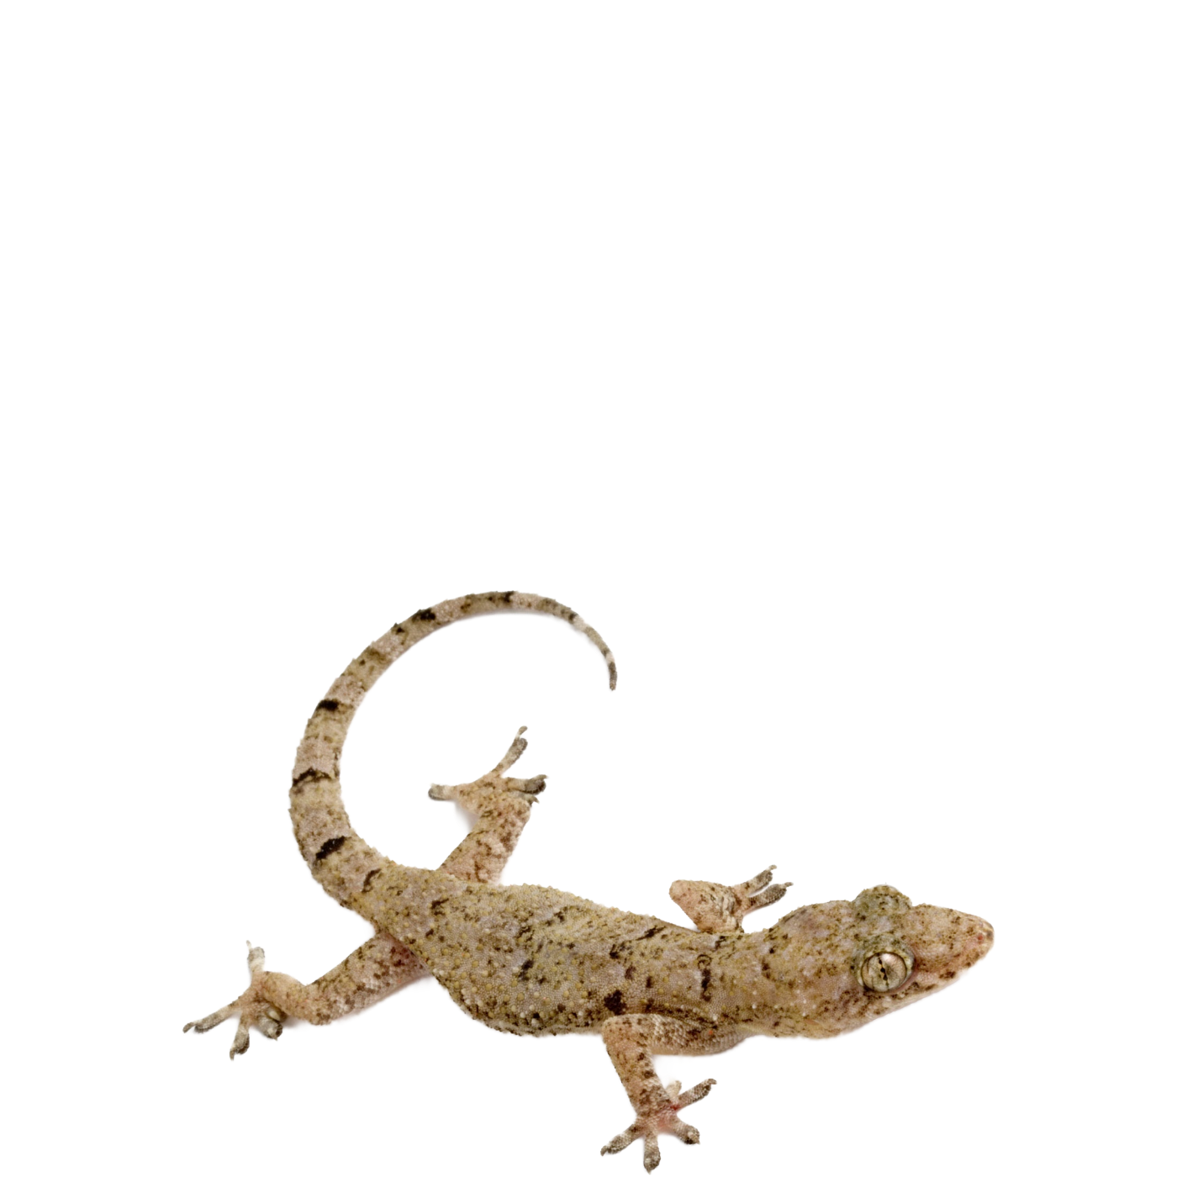

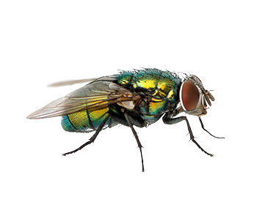
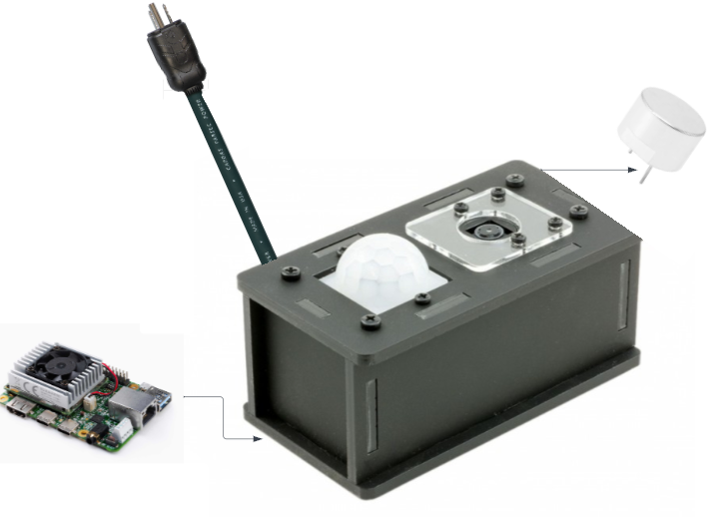
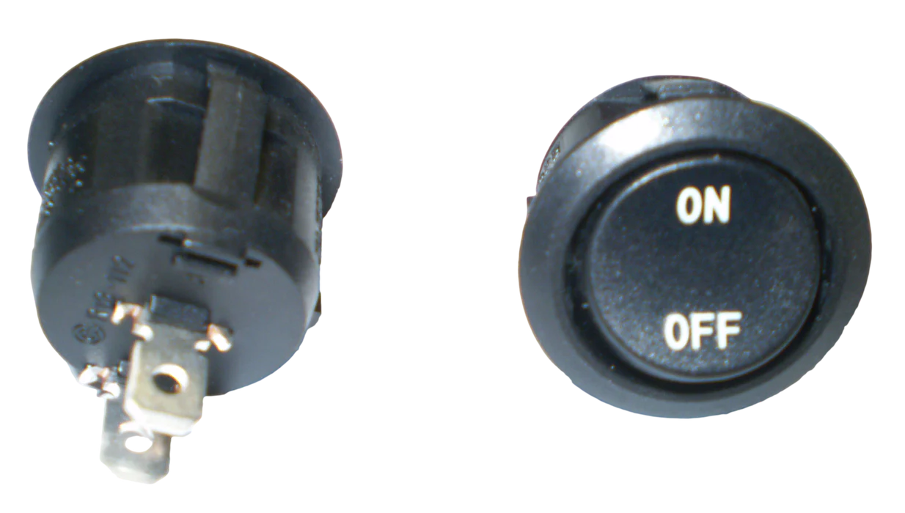
(fleeing animals)

Slide 5
Project Timeline
Subsystem Designs and Testing (completed 3/29) | Integration of power subsystem and MCU (completed 3/28) | Integration of Detection and Emitter System (completed 3/7) | Final Integration (completed 3/28) | System Test (to complete by 4/11) | Validation (to complete by 4/11) | Demo and Report (to complete by 4/19)
Notes:
Eric

Slide 6
Michael McNeil
Accomplishments since last update 15 hrs of effort | Ongoing progress/problems and plans until the next presentation
Ordered/Assembled/Tested New Board Integrated Board with Detection System MCU Fixed Battery Charger issues via new board | Full System Test and Validation Chassis work

Slide 7
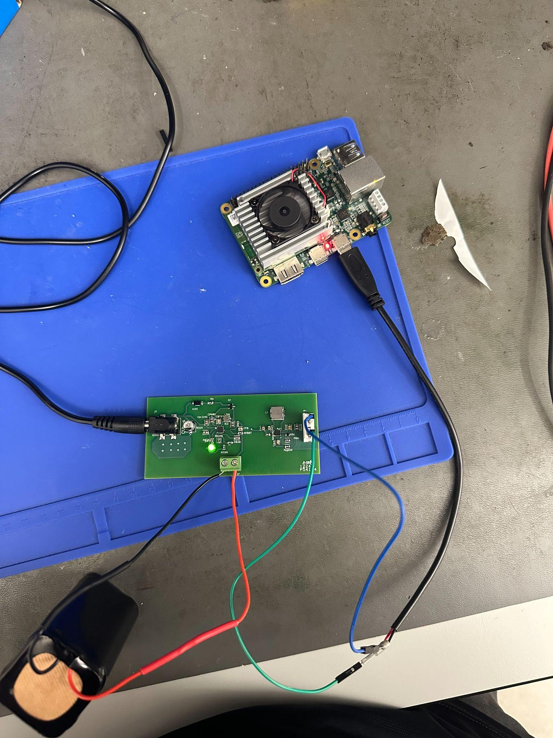
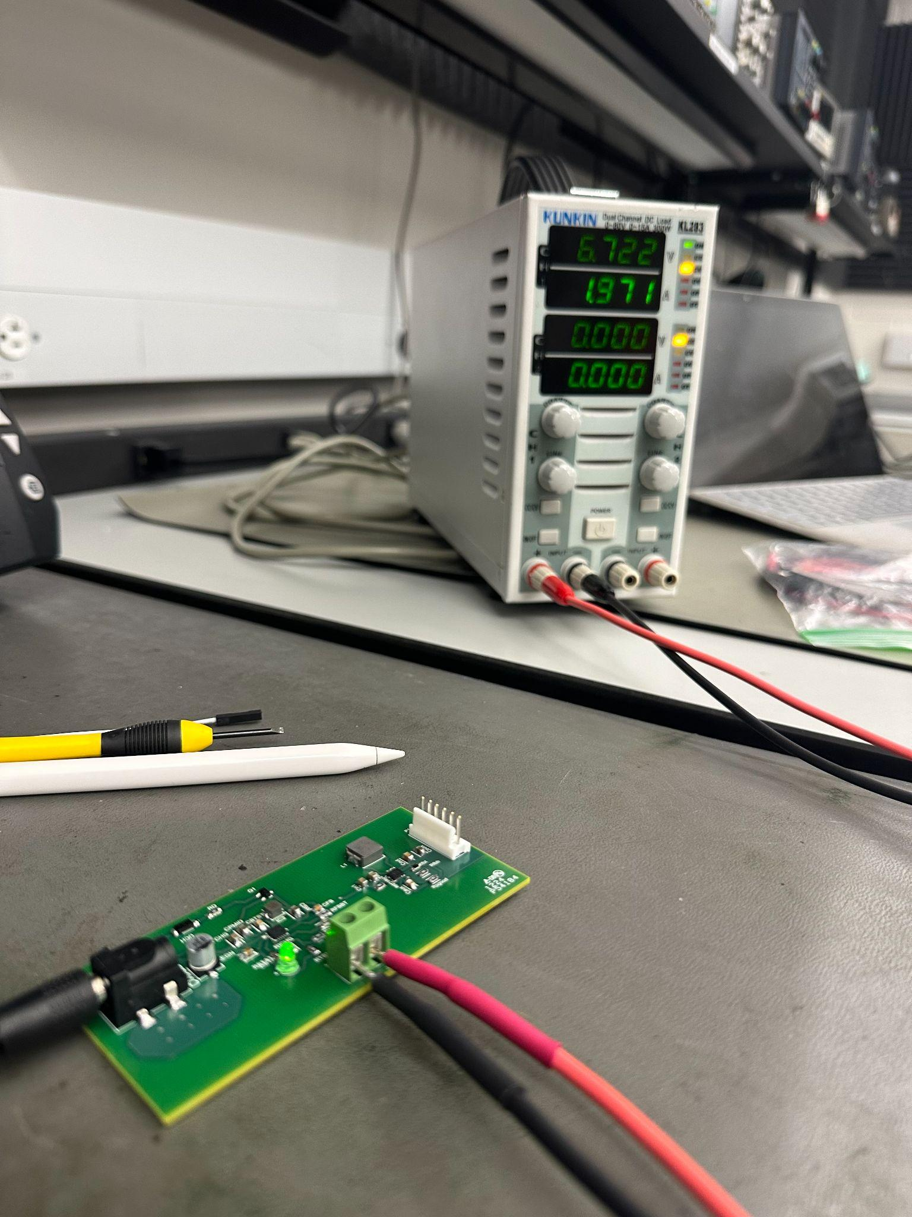
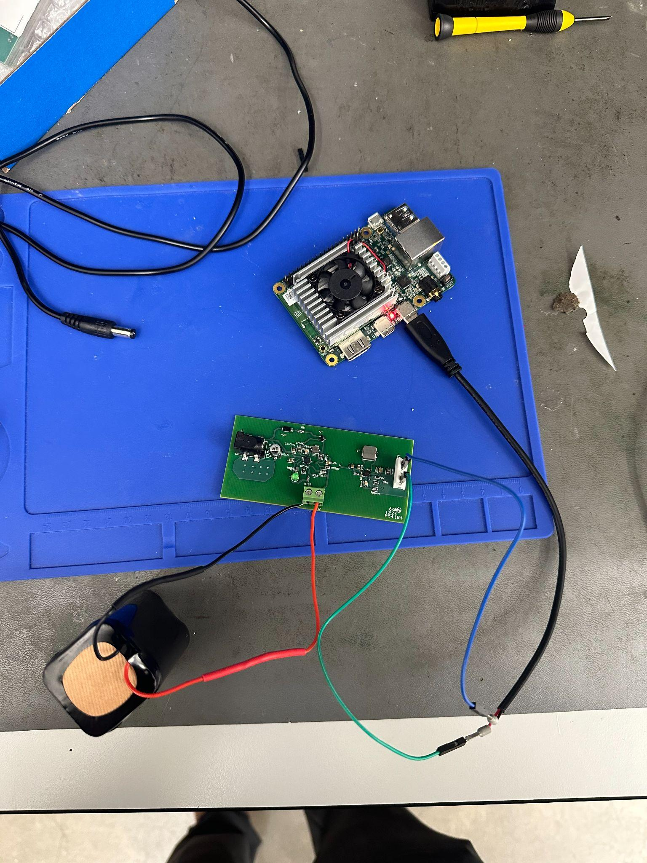
Michael McNeil
Battery Charger Output:
6.99 V and 2 A
Starts Charging when Battery is at ~5V
New board significantly improved voltage drop on load test
Old drop: ~0.45V
New drop: ~0.18V
Stat Indicator:
Blinking: No Battery
High: Charge Done
Low: Charging

Slide 8
Andrew Albritton
Accomplishments since last update 13 hrs of effort | Ongoing progress/problems and plans until the next presentation
Signal generation subsystem validated with ML detection, correct frequency emitted with each different species present. Power Subsystem integrated with MCU | Scenario testing in garden environment. Add on/off switch to chassis Design chassis

Slide 9
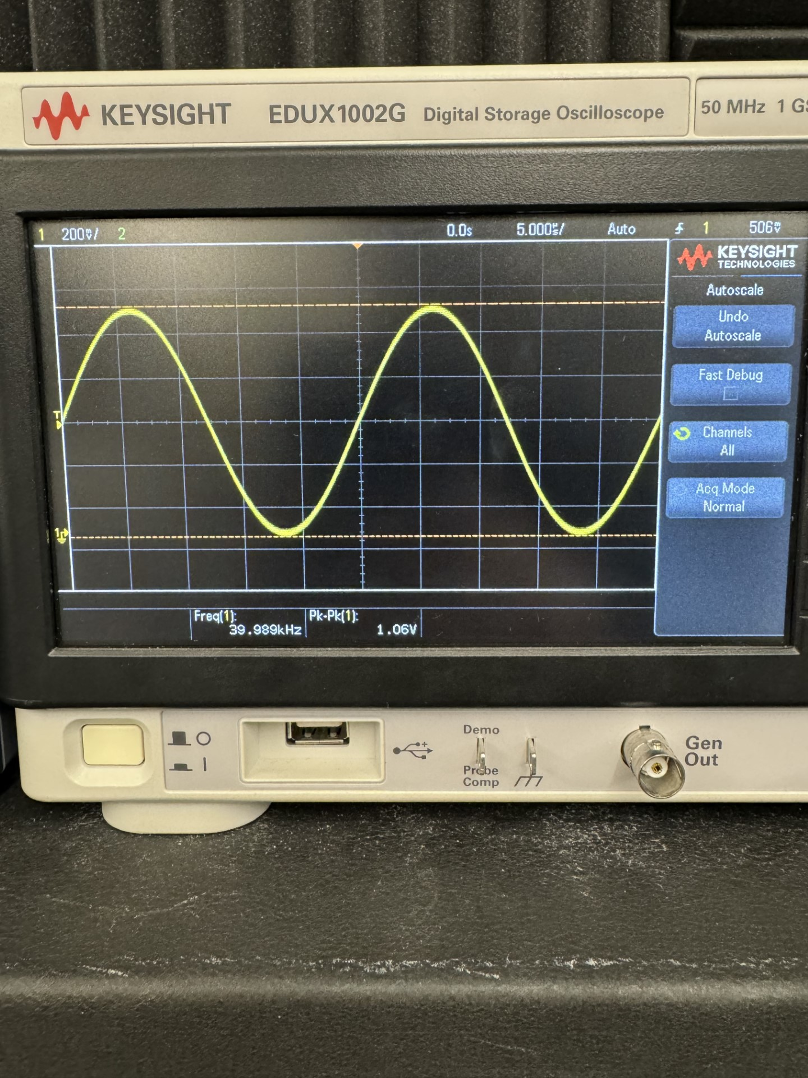
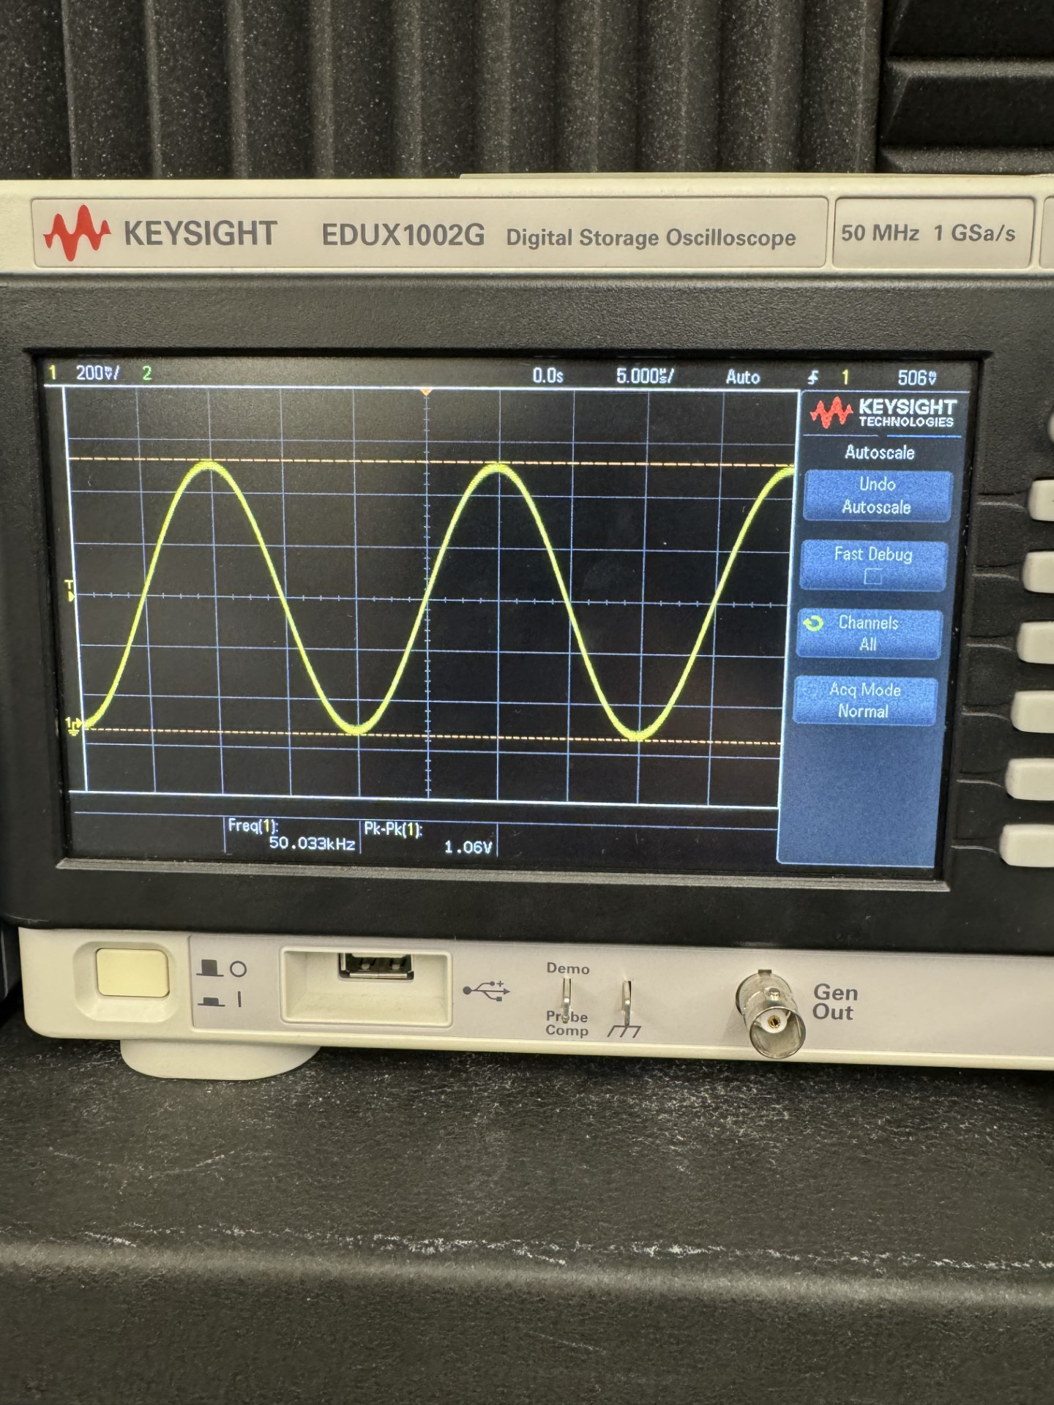
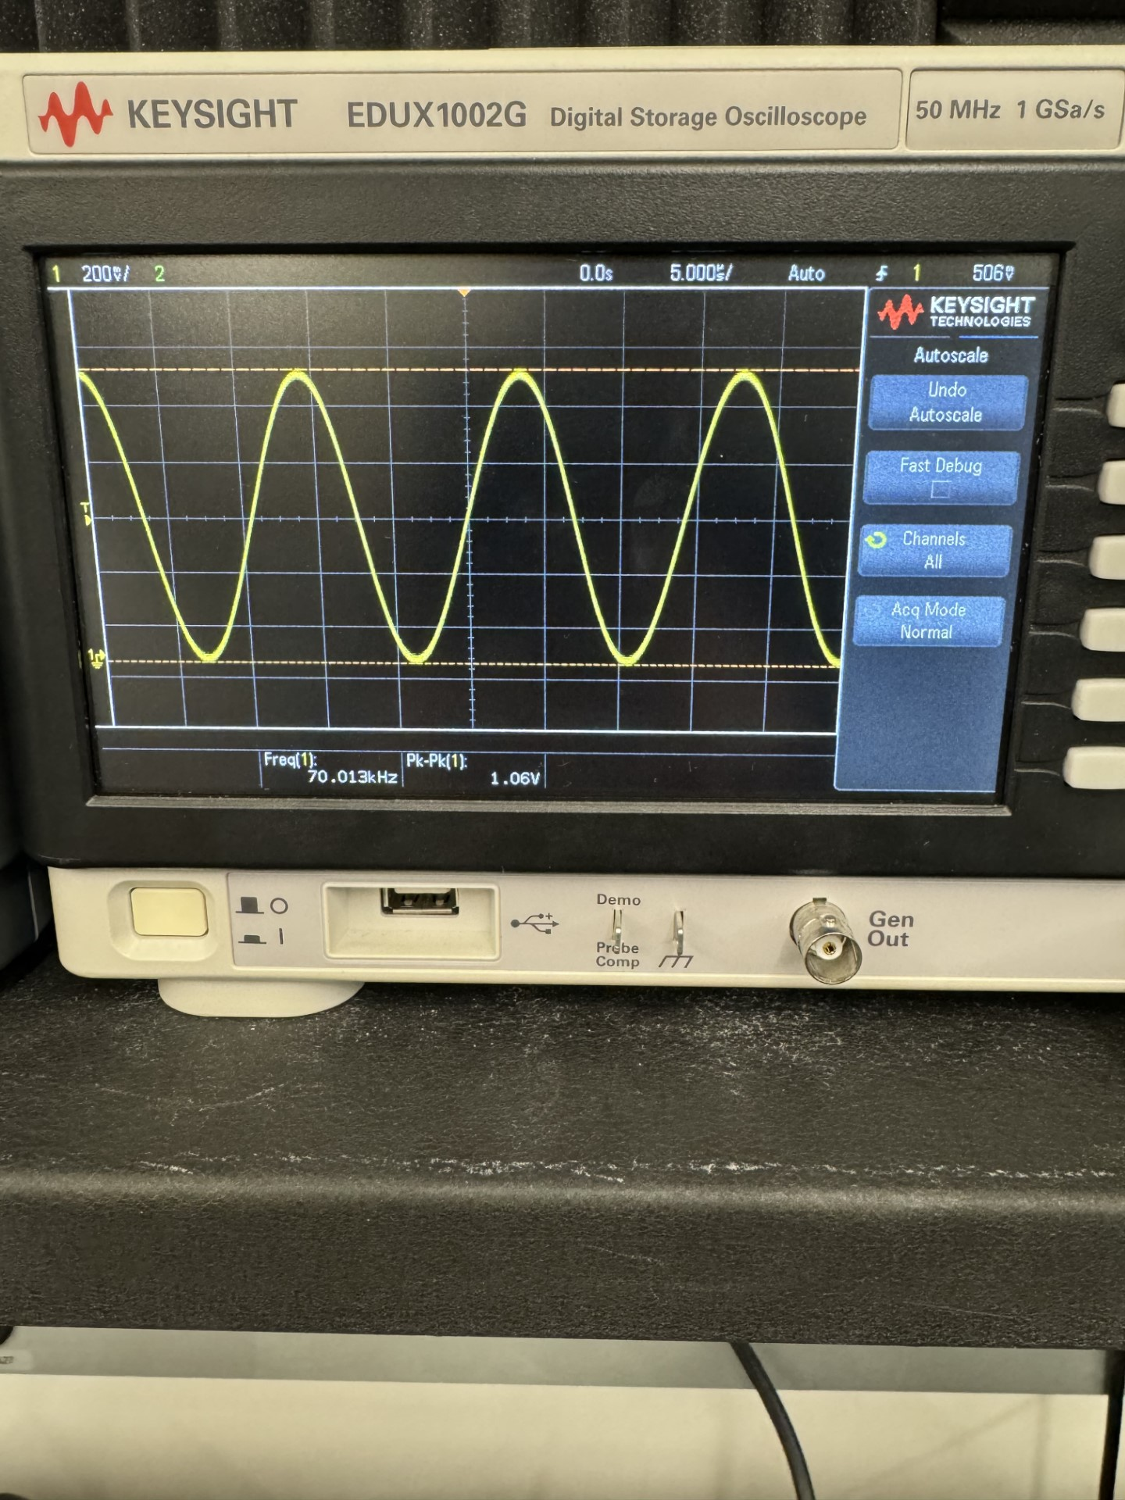
Andrew Albritton
40 KHz (Deters Flies)
Tested with ML detection instead of only testing SPI communication without ML (this is what was done in our last presentation).
50 KHz (Deters Lizards)
70 KHz (Deters Rats)

Slide 10
Melquisedec Ordonez
Accomplishments since last update 19 hrs of effort | Ongoing progress/problems and plans until the next presentation
Tested distance speakers will output. | Strength of each signal,frequency, at maximum distance.

Slide 11
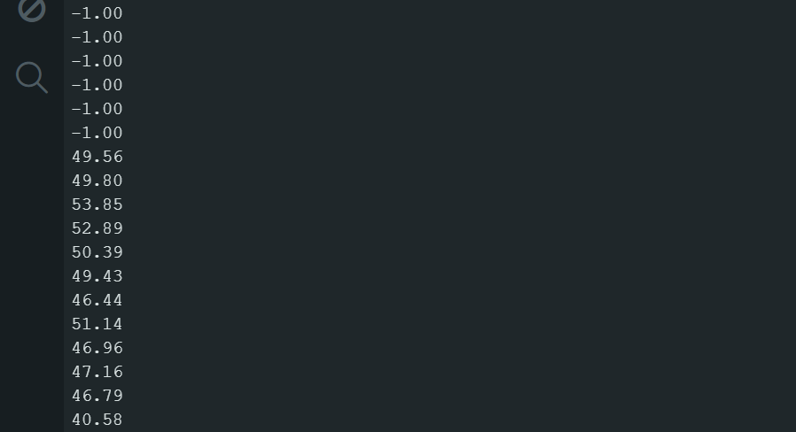
Melquisedec Ordonez
Starts measuring(in cm)
signal coming from ultrasonic emitter
Actual distance closer to 1 ft (~31cm)

Slide 12
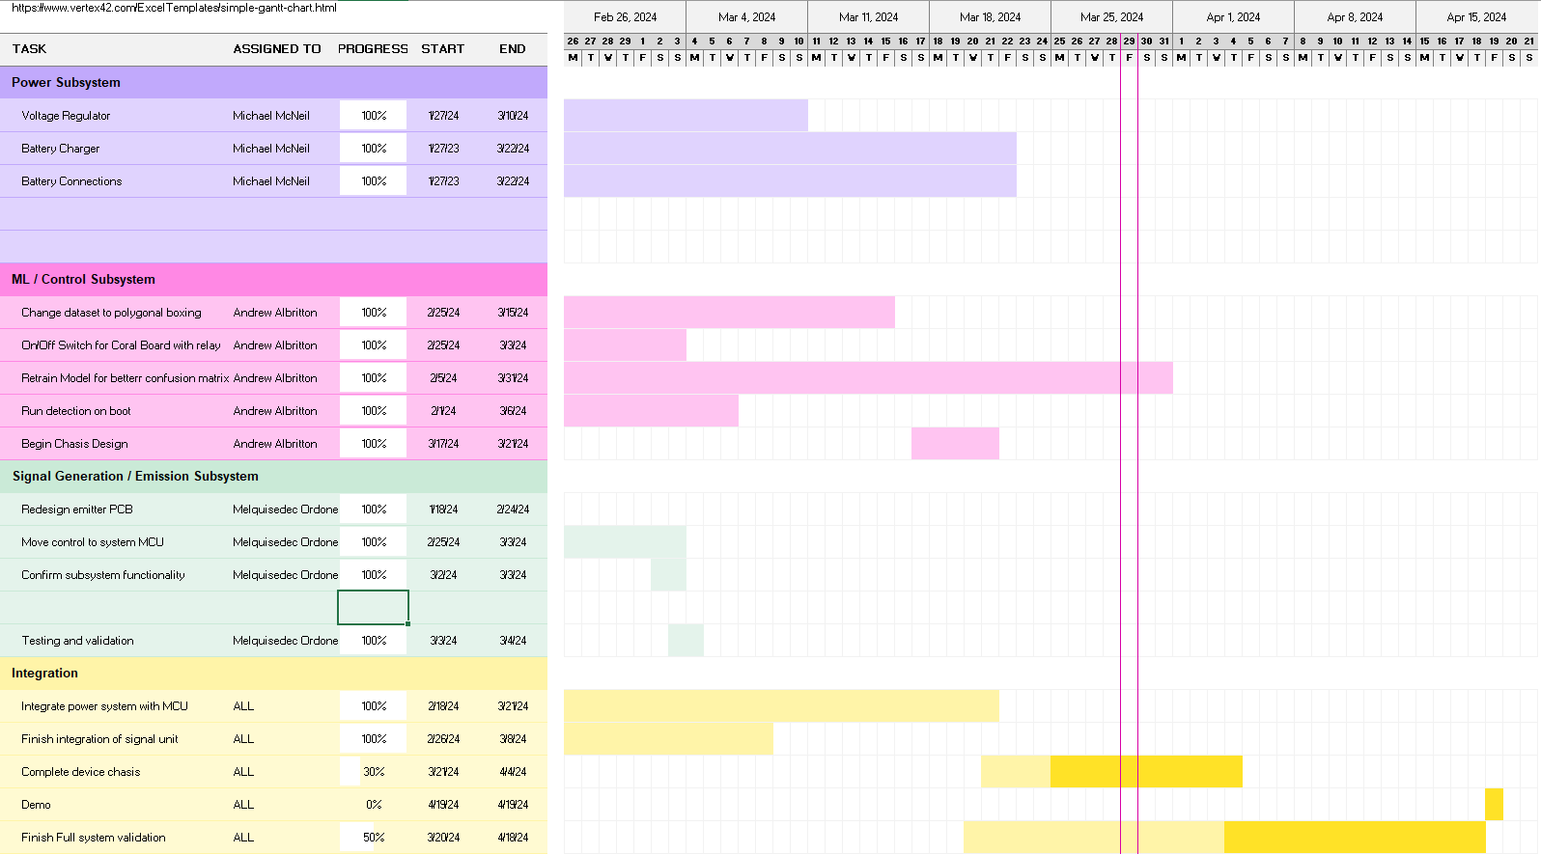
Execution Plan
Notes:
Michelle

Slide 13
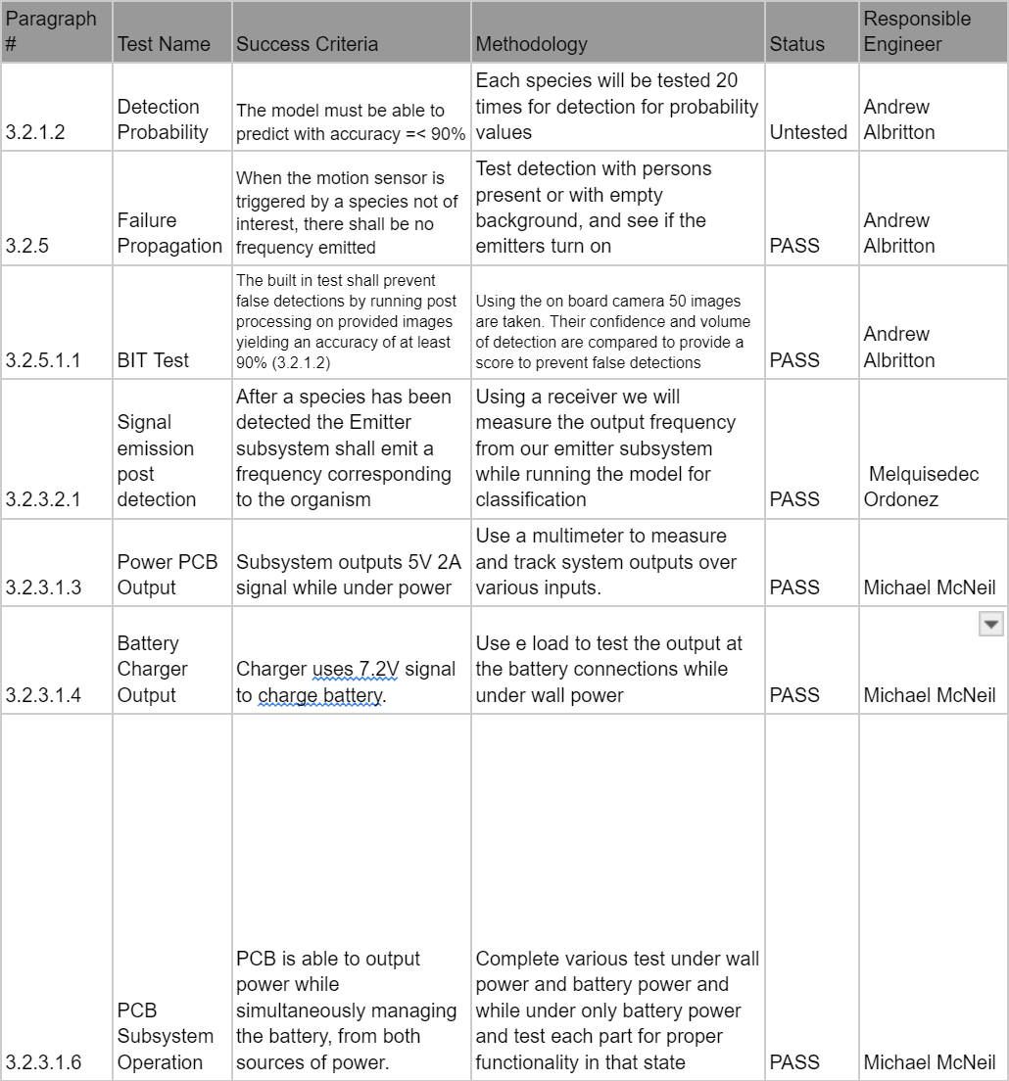
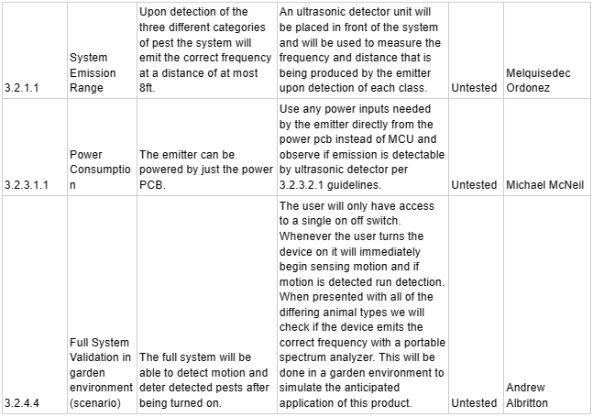
SYSTEM Validation Plan
Notes:
Michelle

Slide 14
Thank you

